Slide 1
In The name of GOG
Chronic Liver Disease and Pregnancy
Mahvash Alizade Naini
1402. Bahman.18

Slide 2
A 32 Year Old Nullipar Lady Has Low Hb & High Alp. She is referred for Pre -Pregnancy counselling Ask Focused Question?
She is nullipar lady, a known of ulcerative colitis (UC) for 5 years (Based on history, colonoscopy, and histologic evaluation).
She had two relapses previously, now her diarrhea is controlled by Mesalazine 1000 mg/TID and
Azathioprine 50 mg BID
Her husband is also a known case of ulcerative colitis controlled with sulfasalazine 1000/BID and folic acid 5mg qd
Body mass index; 25, pale conjunctiva.
CBC: Hb 11 normocytic, normochromic RBC
1) What is (are) etiologic factor(s) for her anemia?
LFT: AST; 21, ALT; 25, AlP; 198, Alb; 3.5 and Globulin; 3.4
2) WHAT ABOUT Dif. Dx?
She has Hx of intermittent post prandial RUQ abdominal pain, pruritus, tea color urine
3) What is the Dif. Diagnosis?
LFT: AST; 42, ALT; 51, AlP; 360, Total bilirubin; 4.5, Direct; 3.1, Alb; 3.5 and Globulin; 3.4
4) What are differential diagnosis and what is the most probable diagnosis?

Slide 3
A 33 Year Old Lady G2. P1. A1. L1, low Hb, High Alp. She is referred for Pre -Pregnancy counselling Ask Focused Question?
She has Hx of two episode of RUQ Abdominal pain with jaundice and pruritus lasting for nearly less than one month, received some medicine with improvement of her symptoms. She ask about
worsening liver -related symptoms during pregnancy or her diseases prognosis
Her husband has rheumatoid arthritis on sulfasalazine and methotrexate
Body mass index; 28 , pale conjunctiva. mild jaundice.
CBC: Hb 10 normocytic, normochromic RBC
1) What is (are) etiologic factor(s) for her anemia?
LFT: AST; 42, ALT; 38, AlP; 470, Alb; 3.3 and Globulin; 4.2
2) WHAT ABOUT Dif. Dx?
She has Hx of intermittent post prandial RUQ abdominal pain, pruritus, tea color urine
3) What is the Dif. Diagnosis?
LFT: AST; 21, ALT; 25, AlP; 300, Total bilirubin; 4.5, Direct; 3.1, Alb; 3.2 and Globulin; 3.4
4) What are differential diagnosis and what is the most probable diagnosis?

Slide 4
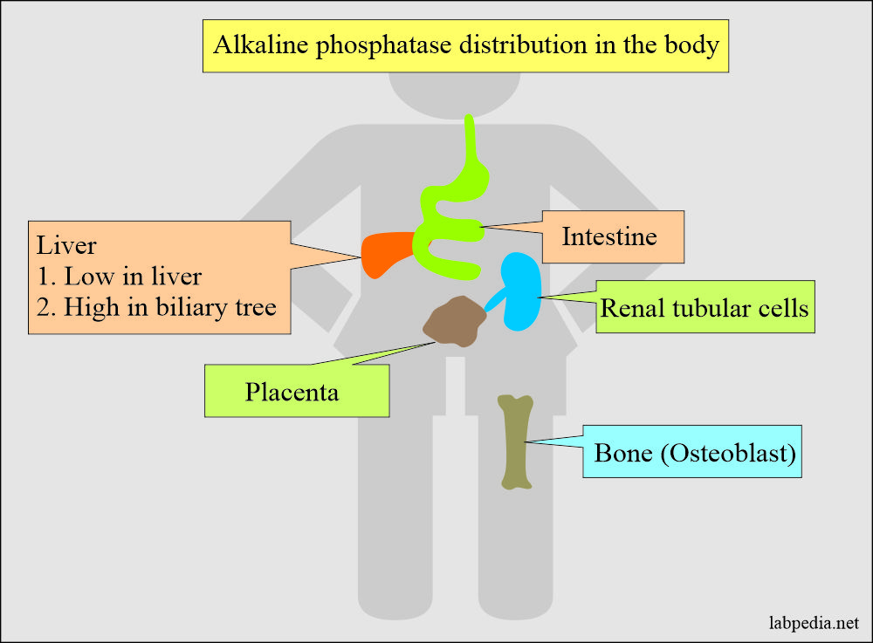
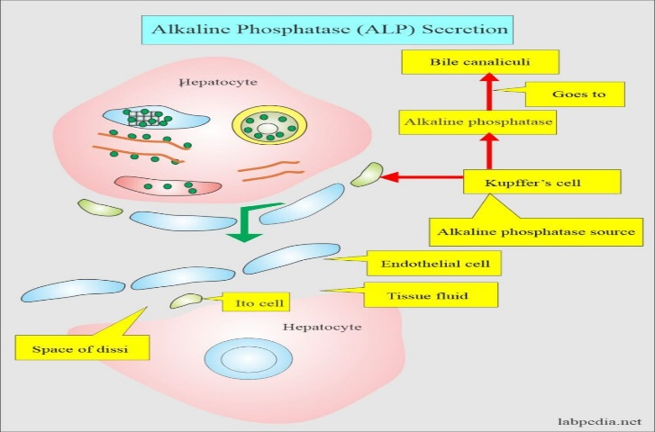
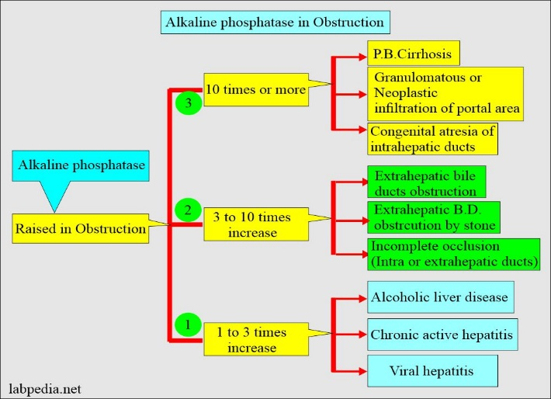
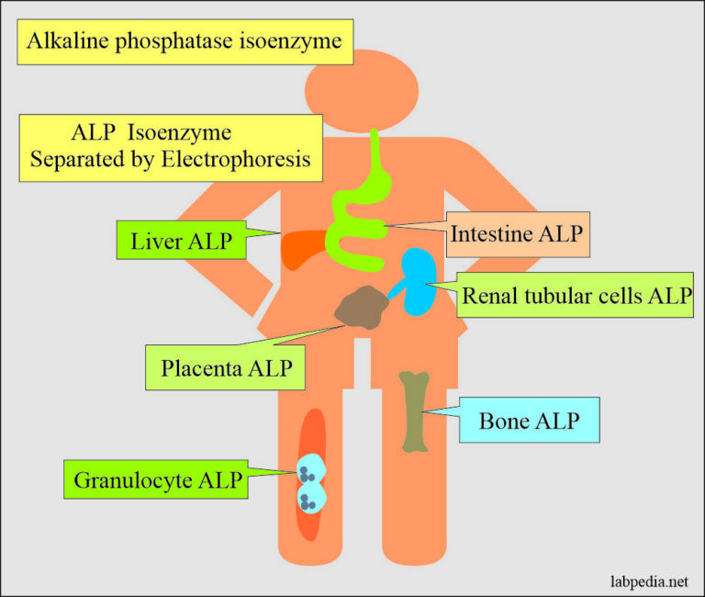
How about the differential diagnosis for these two ladies’

Slide 5
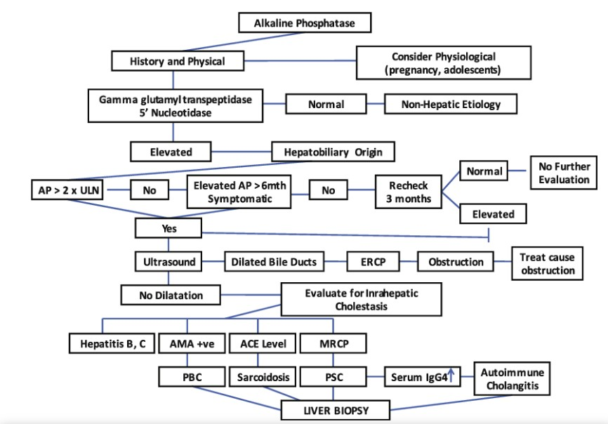
How about the differential diagnosis for these two ladies’ Hereditary cholestasis; Variable syndrome (Alagille, Crigler-Najjar, Dubin-Johnson, or progressive familial intrahepatic cholestasis) are rule oute

Slide 6
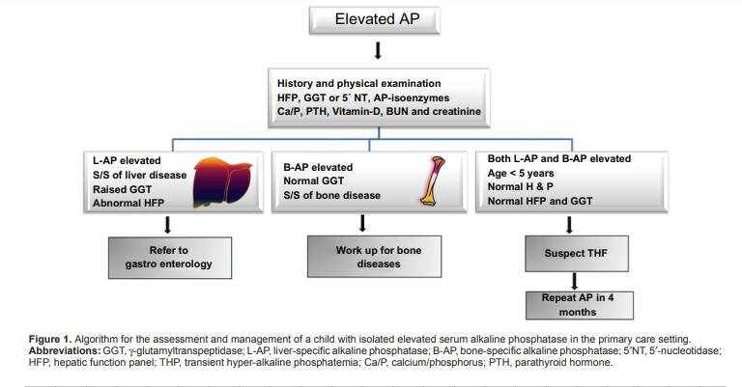
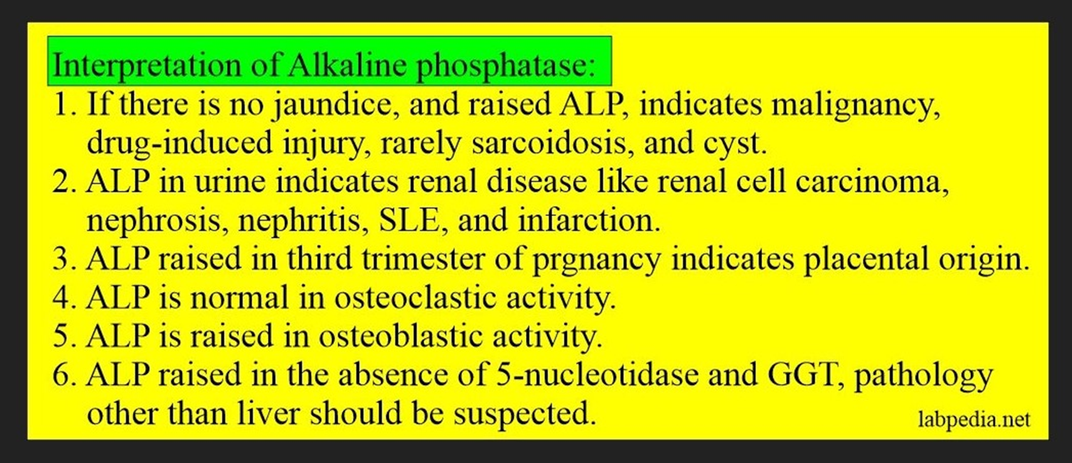
How about the differential diagnosis for these two ladies’

Slide 7
How about the differential diagnosis for these two ladies’
Case No1
CBC: mild anemia
Mild elevation of ALP and GGT
Normal AST, ALT, Albumin.
Globulin and bilirubin
Sonography normal
Anti mitochondrial Ab and IgG 4 are pending
Case No2
CBC: Anemia
High ALP and GGT
Mild rise in AST, ALT,
Normal Albumin. Increased Globulin
and bilirubin (conjugated)
Sonography: CBD mildly dilated
MRCP intermittent dilation of both intra and extra hepatic (beading pattern)
Both of them needs recommendation and information about:
Risk of infertility for them
Risk of pregnancy for themselves
Risk of abortion, dead fetus, and anomaly

Slide 8
Prognosis A; PBC
Women with pre-existing cholestatic diseases should be advised that approximately 50% will have worsening or de novo pruritus during pregnancy, but most women will have stable hepatic function.
Repeated measurement of total serum bile acids should be performed. Higher serum bile acids are associated with reduced gestation length in pre-existing cholestatic liver disorders
Up to 70% of women with PBC had stable or improved PBC
Postpartum increased liver disease activity in 60% to 70%, including liver transplantation in one case
Immunoglobulin M levels and anti-mitochondrial-M2 ab decreased in pregnancy but return in post partum
Fetal outcome in PBC pregnancies is impaired.
Relatively low rate of live births of 58–76%,
Increased rates of preterm delivery of 6–33%
Other neonatal complications of 3–7% were reported.
A study of pregnancies in women with PBC and PSC reported a negative correlation
between the extent of elevation of maternal serum bile acid concentrations and transaminases and the length of gestation

Slide 9
Primary sclerosing cholangitis (PSC)
An immune-mediated chronic liver disease:
Inflammation and fibrosis of the biliary tree
Multifocal biliary strictures
Progressive hepatic fibrosis
Highly variable natural course
No currently licensed medications with a proven prognostic benefit in PSC
A significant life-time risk of progression to end-stage liver disease and
development of Hepatobiliary malignancies
How about pregnancy???
Patients should be informed about:
The probable problems with conception
Probable progression of signs and symptoms
The fetal problems
The side effects of some workups and medications
The method of management
How about Mesalazine, sulfasalazine, methotrexate. And Azathioprine

Slide 10
Primary sclerosing cholangitis (PSC)
PSC is commonly diagnosed at 25-40 years of age, and although there is male preponderance, a significant proportion of patients with PSC are females of
child-bearing age during a period of peak fertility
Maternal PSC is associated with an increased risk of pre-term birth and
caesarean section
No demonstrable risk of still birth, neonatal death, or congenital abnormalities
compared with the general population
Fertility is not affected by PSC!!
Evaluating the effect of pregnancy on maternal liver disease is particularly
pertinent in PSC
Pregnancy can have a variable effect on the course of immune-mediated diseases
including
Inflammatory bowel disease (IBD) which is common in PSC,
Hormonal changes in pregnancy can contribute to the development of intrahepatic
cholestasis of pregnancy (ICP)

Slide 11
Primary sclerosing cholangitis (PSC)
Fetal and maternal outcomes
Outcome in PSC depend on the concurrent management of liver and bowel disease that may be independently associated with adverse pregnancy outcomes
Maternal outcome in PSC pregnancies is impaired.
De novo pruritus and abdominal pain are the most frequently reported symptoms during pregnancy.
Most women have stable serum liver tests; notably, due to use of ursodeoxycholic
acid (UDCA) during pregnancy
Up to one-third of the mothers had deterioration in serum liver tests postpartum
For new symptoms or worsening liver tests during pregnancy, the development
of relevant bile duct strictures should be considered in PSC.

Slide 12
Primary sclerosing cholangitis (PSC)
Liver-related symptoms are frequently encountered during pregnancies before
the diagnosis of PSC
Pregnancy may expose the pre-clinical phase of PSC in some patients.
Worsening liver-related symptoms were seen in a third of cohort with known
PSC during pregnancy
This subgroup had a poorer prognosis, which may be related to more advanced
liver disease at time of pregnancy and/or a more severe disease phenotype.
Patients with PSC can develop worsening of their liver-related symptoms during pregnancy; but the risk factors for this and the long-term implications are not
known.
There is a significant risk of these symptoms in pregnancy, both before and after PSC has been diagnosed, particularly in patients with elevated ALP.
Furthermore, our findings suggest that worsening symptoms during pregnancy
may be associated with adverse outcome

Slide 13
Diagnostic approach
Radiological investigations
Ultrasound Safe at any gestation in pregnancy It should be noted that there may be a small increase in liver stiffness and controlled attenuation parameter in the third trimester which reflects the physiology of normal pregnancy3
MRCP MRCP, magnetic resonance cholangiopancreatography; Safe at any gestation in pregnancy
ERCP endoscopic retrograde cholangiopancreaticography; Imaging with ultrasound or magnetic resonance cholangiopancreaticography is recommended in primary sclerosing cholangitis, when cholestasis worsens, to exclude obstruction by gallstones or progress of high-grade strictures that are accessible to endoscopic balloon dilatation Fetal radiation estimated Between <0.1-0.5 mGy4 (threshold for malformation = 50 mGy) Can be performed in pregnancy, ideally in the 2nd/3rd trimester
Other
OGD, oesophago-gastroduodenoscopy Safe at any gestation in pregnancy Safe in pregnancy, ideally performed in 2nd trimester in left lateral position Midazolam may be used judiciously
Liver Biopsy Can be performed where clinical need/diagnostic uncertainty dictates, and delay in diagnosis would be more dangerous for the pregnant woman Ensure coagulopathy corrected

Slide 14
Primary sclerosing cholangitis (PSC)
Ursodeoxycholic acid should be continued during pregnancy in primary biliary cholangitis
(and primary sclerosing cholangitis when treated) as it is safe in pregnancy and breastfeeding
**Obeticholic acid use is currently not recommended in pregnancy or during lactation in
women with primary biliary cholangitis or primary sclerosing cholangitis due to a lack of
safety data, while fibrates may be used after the first trimester if the clinical team believes that the benefits outweigh the risks
For women with de novo or worsening pruritus, suggested treatments include rifampicin (300-600 mg daily) and anion exchange resins (Cholestyramine, 4-8 g/day or Colestipol, 5–10 g/day),
***the latter given at least 4 hours after ursodeoxycholic acid
Additional therapies that may improve maternal pruritus can be considered,
guar gum and activated charcoal, but current evidence to support their use is limited
***Vitamin K deficiency related to cholestasis and/or use of anion exchange resins or
rifampicin should be corrected
All women with chronic liver disease or a history of gestational liver disease should be offered
pre-pregnancy counselling from a team with expertise in management of these disorders

Slide 15
Take home important massage
1: Do not forget History Taking & Physical Examination. Even…….
2: It should be Easy to Remember; Our Information is not Enough to Detect and Manage All Problems. Not Only ALL, But a Little of Them !!
3: Be ONEST and Document All Data About the Patients,
Their Management Plan, and the Results.
4: ….And the Most Important:
The Successful Patients Management, Especially Pregnant Patients
with any Medical Problems such as Liver Disease Requires
Multi disciplinary Approach with Close Collaboration
Between Obstetricians, Internists, Hepatologists, and Surgeon.

